Slide 1
205 Feb 7, Class 15
Experiment 2 analysis
Writing feedback
Scientific writing
Introduction: framing the question
Discussion: drawing inferences
Expanding the background research

Slide 2
Experiment 2 data
Exp2_Winter2024.csv/.xlsx
Running the analysis in R
Reporting the results
Making a graph

Slide 3
Results
Main effect of stimulus meaning
F(X,X) = Y.YY, p<.0z
Main effect of deep/shallow encoding
F(X,X) = Y.YY, p<.0z
Interaction
F(X,X) = Y.YY, p<.0z

Slide 4
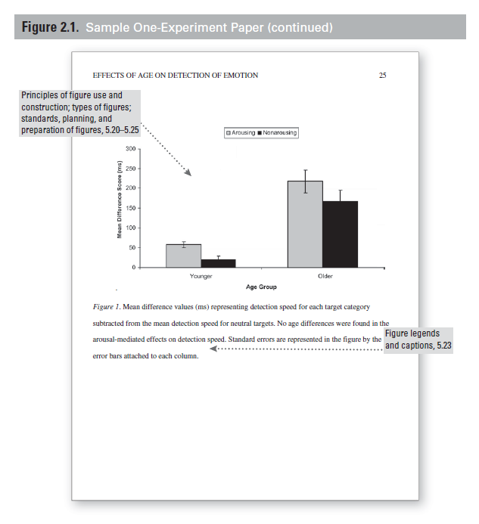
First paper feedback
Follow the provided guidelines
Method: Participants, Materials, Procedure
Use the recommendations on framing Results
Double-check that all the numbers are there and correct
Review the provided sample manuscript paper for overall format

Slide 5
Writeup #2
Include both Experiment 1 and Experiment 2
Methods for Experiment 2 available on Canvas
Make corrections to Experiment 1
Expand the Introduction
What is “deep” encoding?
Why do we hypothesize that “deep” encoding leads to better memory?
What is new about the studies you are reporting?
Expand the Discussion
Summarize results of both experiments
What do they mean with respect to the hypothesis?
Refer back to theory from the Introduction

Slide 6
Multi-experiment papers
Abstract
Introduction
Experiment 1
Method
Results
Discussion (short, segue)
Experiment 2
Method
Results
Discussion (optional)
General Discussion
References

Slide 7
Formatting details
References
Figures & Captions
Pagination
Title
Abstract
Double-spaced

Slide 8
Writing with Style
Reading published work focused on style
How they communicate instead of what
Using Google Scholar
Search by keywords
Find @ NU
Cite & Cited by links
Peer-reviewed journals
Avoid “Proceedings”

Slide 9
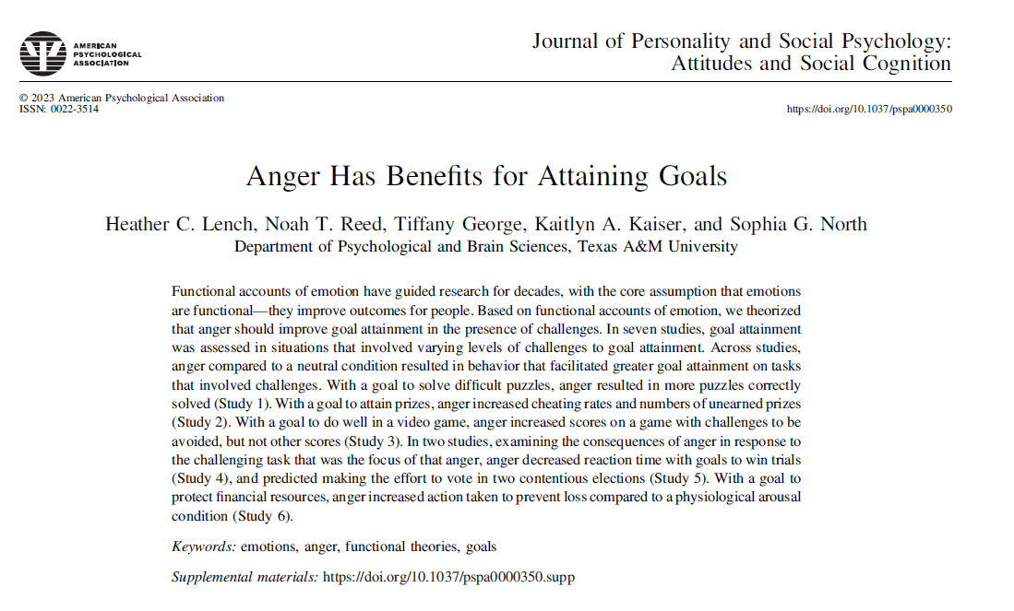

Slide 10
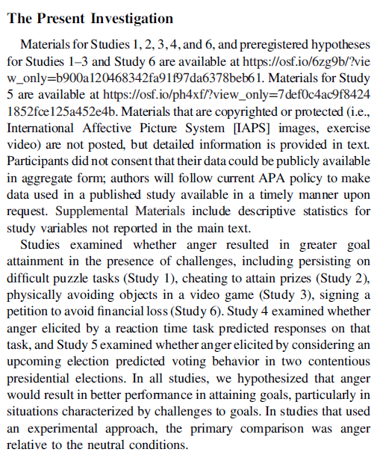
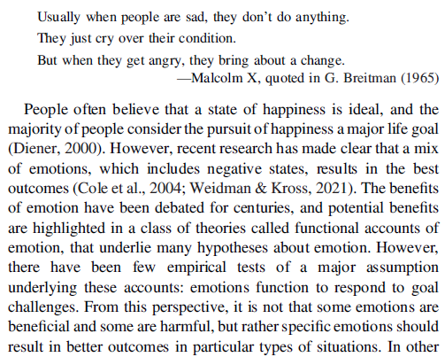
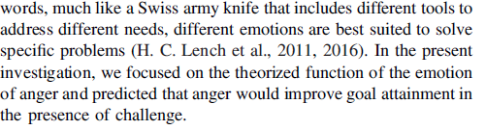

Slide 11
Study 1
Study 1 was designed such that participants’ goal was to solve more puzzles. Anger was expected to increase goal attainment (i.e., number of puzzles solved) relative to a neutral state on challenging puzzles. The difficulty of the puzzles in this situation can be overcome with greater persistence in attempting to solve the puzzles, and therefore, we also examined persistence on the task. In addition to comparison to a neutral condition, the effects of anger were compared to the effects of other states that varied in their valence and approach orientation.

Slide 12
Methods
Participants were randomly assigned to emotion condition (anger, neutral, amusement, desire, sadness). Emotions were elicited through images that forwarded automatically in a slide show consisting of fifteen images displayed for 5 s each (a common emotion elicitation associated with medium-to-large effect sizes; H. C. Lench et al., 2011). Images from the IAPS (Lang, 1995) were chosen that have been shown to elicit amusement, sadness, anger, or neutral emotion in the previous standardization studies (Mikels et al., 2005).1 The number of IAPS images that elicit anger specifically is relatively small, and therefore, we developed seven images specific to the study population (e.g., insults to the university football team).

Slide 13
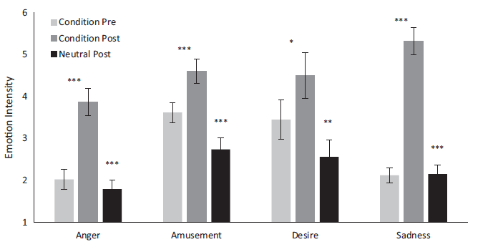
Manipulation check

Slide 14
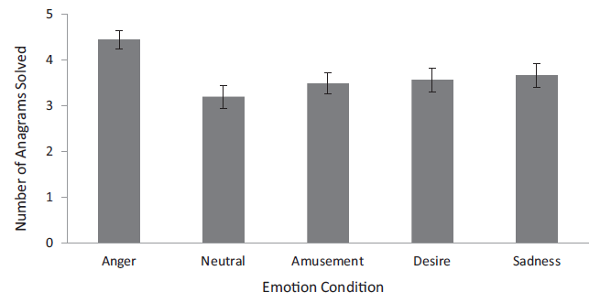
Anagrams solved
As shown in Figure 2, an analysis of variance (ANOVA) revealed that emotion condition affected the number of anagrams correctly solved on the difficult first set, F(4, 228) = 3.65, p = .007, η2 p = .06. The primary contrast of interest showed that participants in the anger condition solved more anagrams than those in the neutral condition, t(90) = 3.82, p < .001, d = .81. Compared to the neutral condition, this represents a 39.18% improvement in goal attainment (anagrams solved) when angry.

Slide 15
Additional studies
Study 2: anger led to more cheating (false self-report) on hard puzzle solutions
Study 3: video game play – skiing on Wii balance board
Hard/easy game
5 emotion levels
Anger led to better scores on only harder game
Study 4: decreased reaction times after unfair game
Study 5: non-experimental study comparing anger and voting tendency

Slide 16
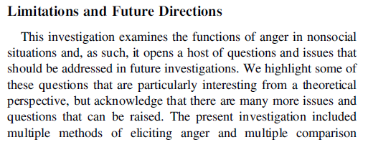
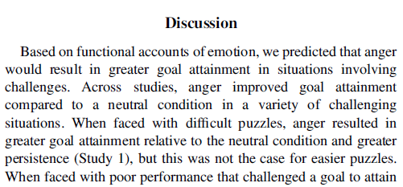
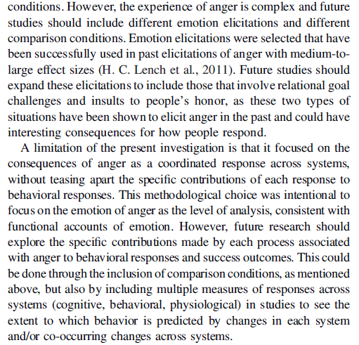
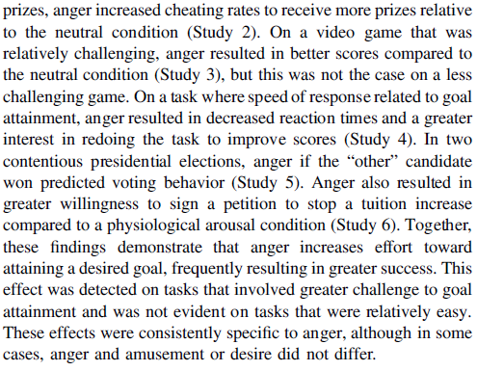

Slide 17
For Fri 2/9
Chapter 13, Developing a Research Proposal
Finding background reference that might be a good starting point for your final project
Use this paper as a writing example to look at style of writing the Introduction and Discussion

